Slide 1

Dynamic Web
Lesson - 7
Orion Innovation
Company Overview

Slide 2
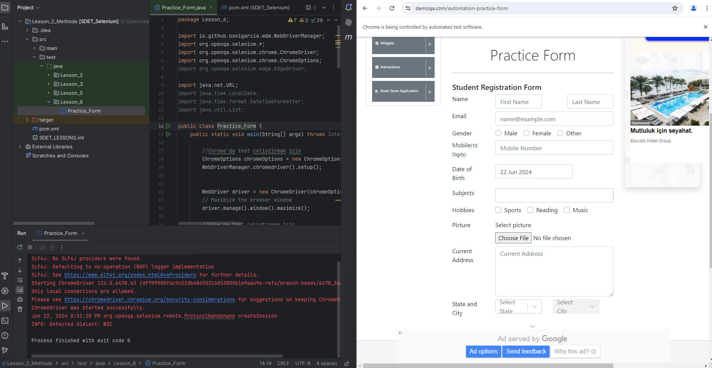
Previous Week’s Highlights
https://demoqa.com/automation-practice-form
Automation Codes on MsTeams

Slide 3
Content
Introduction to Dynamic Web Elements
Handle Dynamic Web Elements with XPath
XPath Selector Examples
CSS Selector Examples

Slide 4
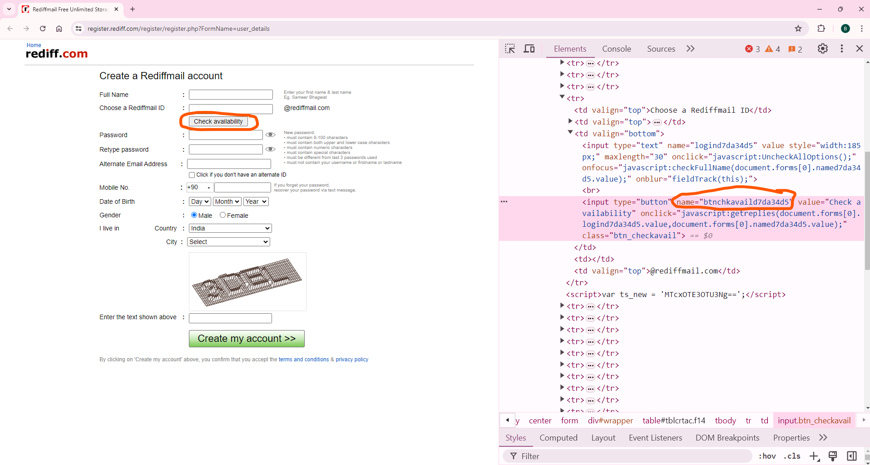
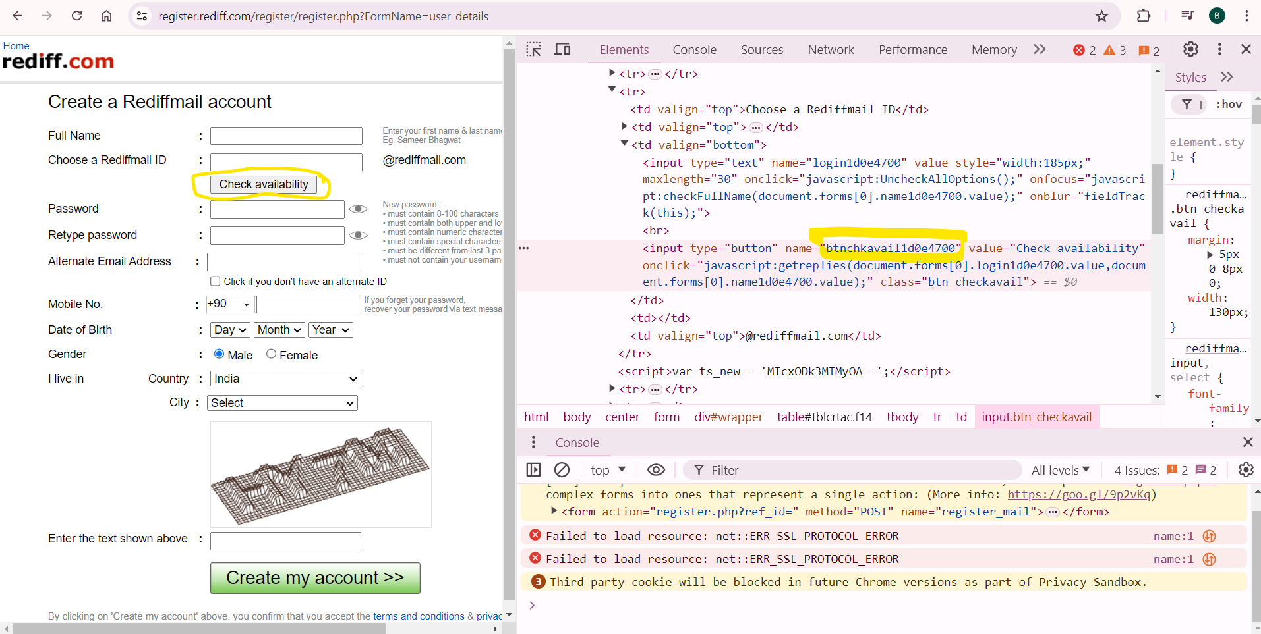
Dynamic Web Site Examples
Rediff.com
Before the refresh the web page - “name” attribute value
After the refresh the web page - “name” attribute value
https://register.rediff.com/register/register.php?FormName=user_details

Slide 5
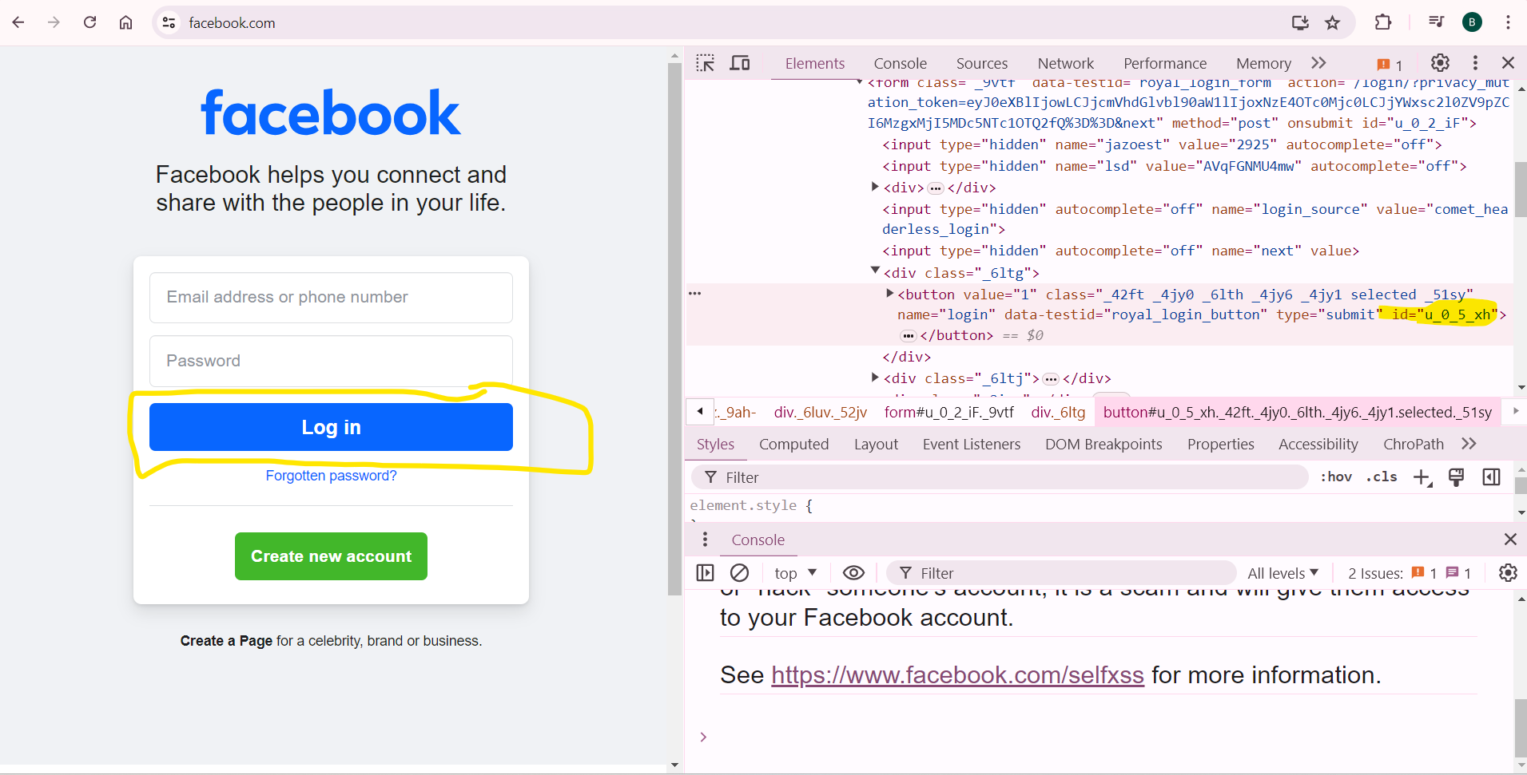
Dynamic Web Site Examples
Facebook.com
https://www.facebook.com/

Slide 6
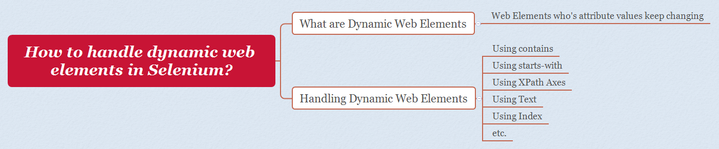
Handle Dynamic Web Elements with XPath
Source: [1] How to handle dynamic web elements in Selenium (Selenium Interview Question #233)

Slide 7
Using Contains
//tagname[contains(@attributeName,'attributeValue')]

Slide 8
Using Starts with
//tagname[starts-with(@attributeName,'attributeValue')]

Slide 9
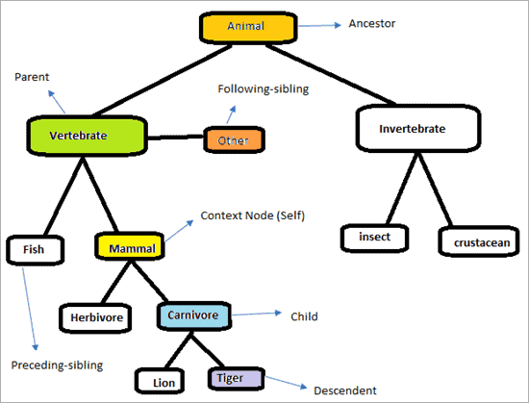
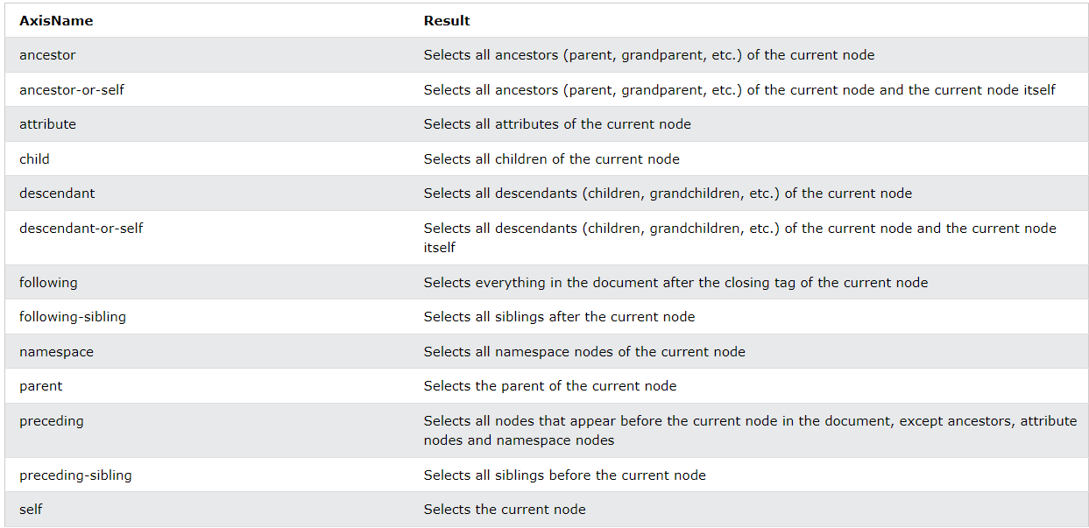
Using XPath Axes
Source: [2] Structure Of XPath Axes
Source: [3] Table of XPath Axes

Slide 10
Using Text
//tagName[contains(text(),'StringText')]

Slide 11
Using Index
<html>
</head>
<body>
<table>
<tr>
<td> <input type = "text" value = “B"> </td>
<td> <input type = "text" value = “A"> </td>
</tr>
<tr>
<td> <input type = "text" value = "R"> </td>
<td> <input type = "text" value = “I"> </td>
<td> <input type = "text" value = “S"> </td>
</tr>
</table>
</body>
</html>
XPath group index | Matching element
//input | BARIS
(//input)[1] | B
(//input)[2] | A
(//input)[3] | R
(//input)[4] | I
(//input)[5] | S
(//input)[last()] | S

Slide 12
XPath Selector Cheat Sheet
XPath Methods | Syntax
//* | Select all
/ | Select the next immediate level item
// | Anywhere in the selected scope
/.. | Parent of
:: | In the Scope of
//tagName | //tagName[@attribute='value']
Contains() and text() methods | //*[contains(text(),'value')]
 | //tagName[contains(text(),'value')]
 | //tagName[contains(@attribute,'value')]
AND | //tagName[@attribute='value' and @attribute='value']
OR | //tagName[@attribute='value' or @attribute='value']
Starts-with | //tagName[starts-with(@attribute, 'value')]
Self | //*[@attribute='value']//self::tagName
Following | //*[@attribute='value']//following::tagName
Following-sibling | //*[@attribute='value']//following-sibling::tagName
Ancestor | //*[@attribute='value']//ancestor::tagName
Preceding | //*[@attribute='value']//preceding::tagName
Descendant | //*[@attribute='value']//descendant::tagName
Parent | //*[@attribute='value']//parent::tagName
Child | //*[@attribute='value']//child::tagName

Slide 13
XPATH Selector EXAMPLES

Slide 14
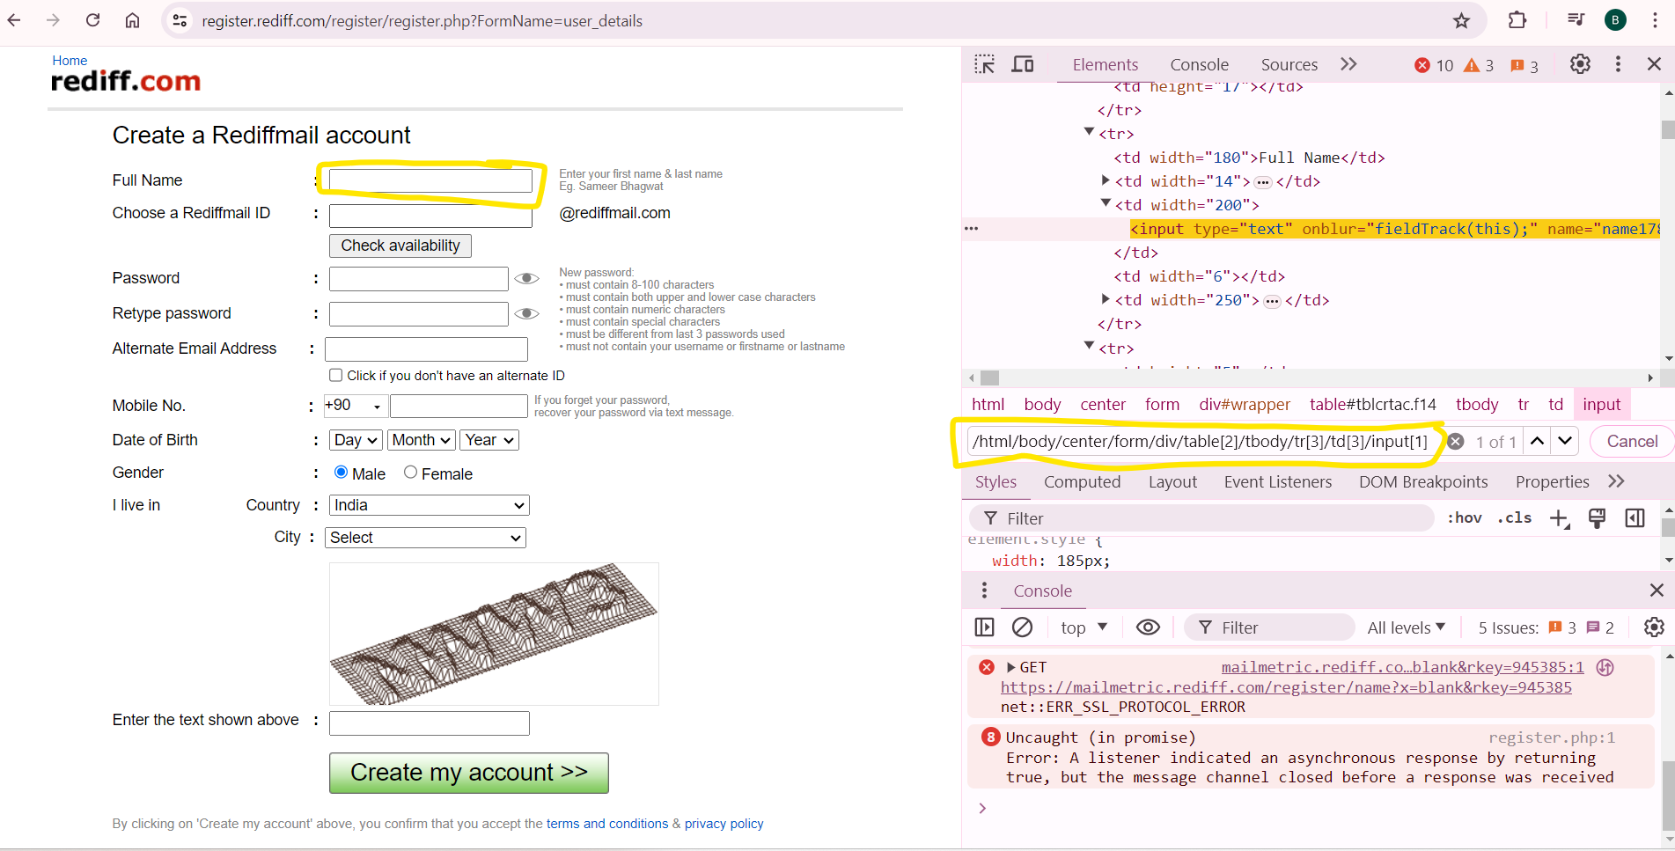
Using Single Slash
/html/body/center/form/div/table[2]/tbody/tr[3]/td[3]/input[1]
https://register.rediff.com/register/register.php?FormName=user_details

Slide 15
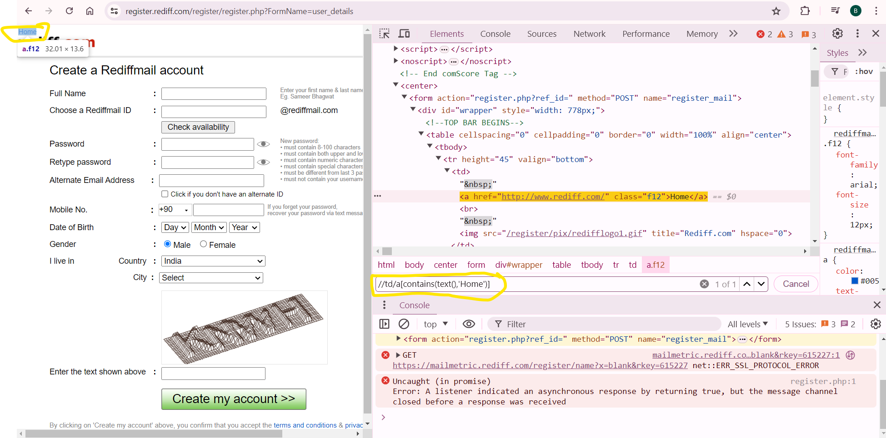
Using Double Slash
//td/a/[contains(text(),’Home’)]
https://register.rediff.com/register/register.php?FormName=user_details

Slide 16
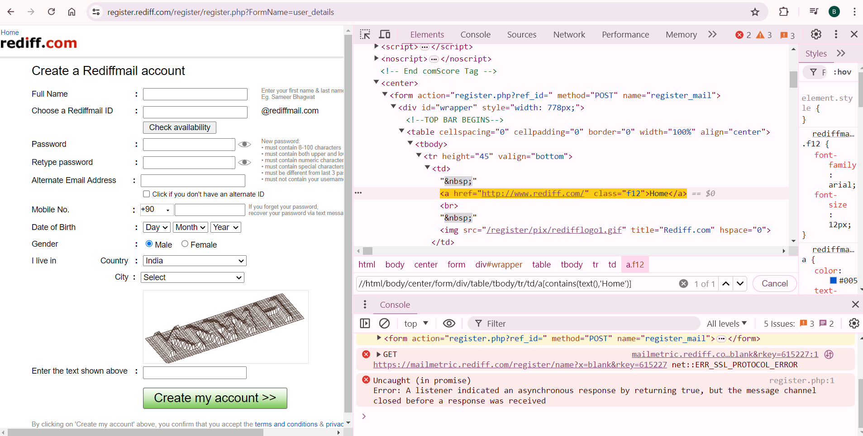
Using Double Slash with Absolute path
//html/body/center/form/div/table/tbody/tr/td/a[contains(text(),'Home')]
https://register.rediff.com/register/register.php?FormName=user_details

Slide 17
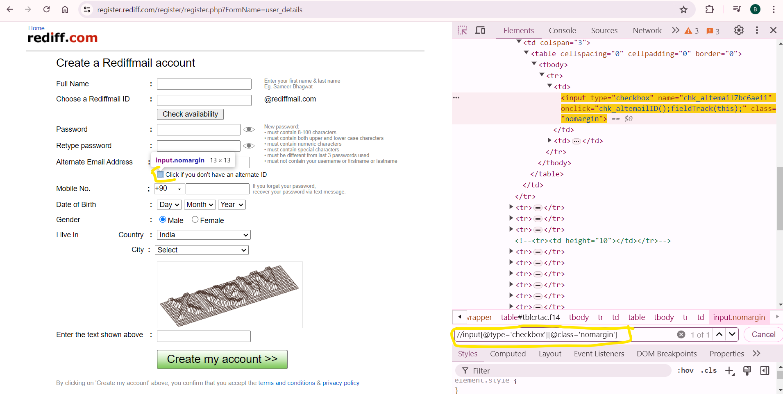
Using Multiple Attributes
//input[@type='checkbox'][@class='nomargin']
https://register.rediff.com/register/register.php?FormName=user_details

Slide 18
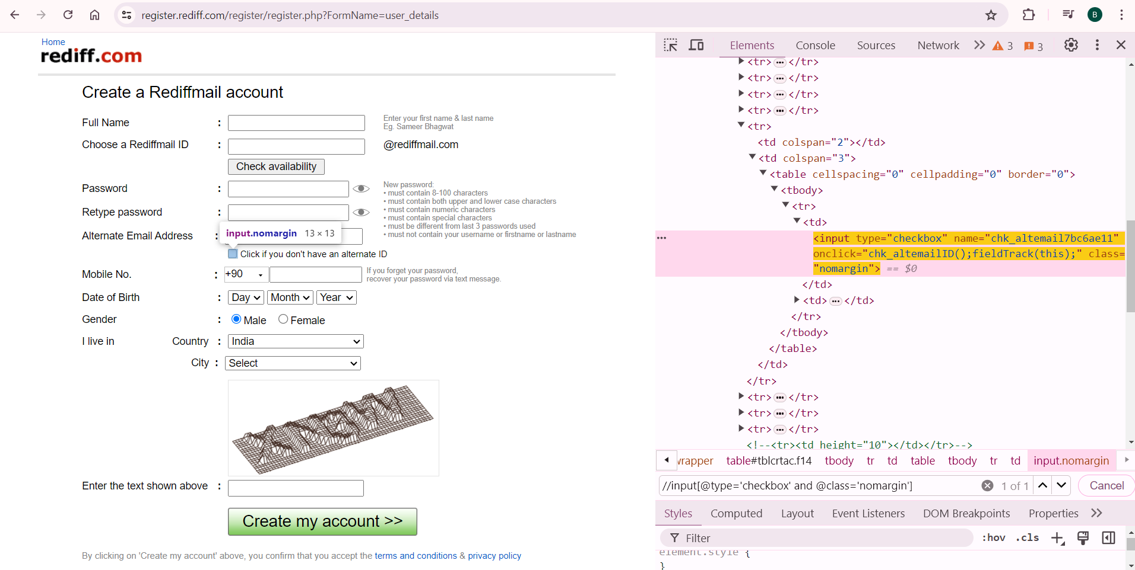
Using AND
//input[@type='checkbox' and @class='nomargin']
https://register.rediff.com/register/register.php?FormName=user_details

Slide 19
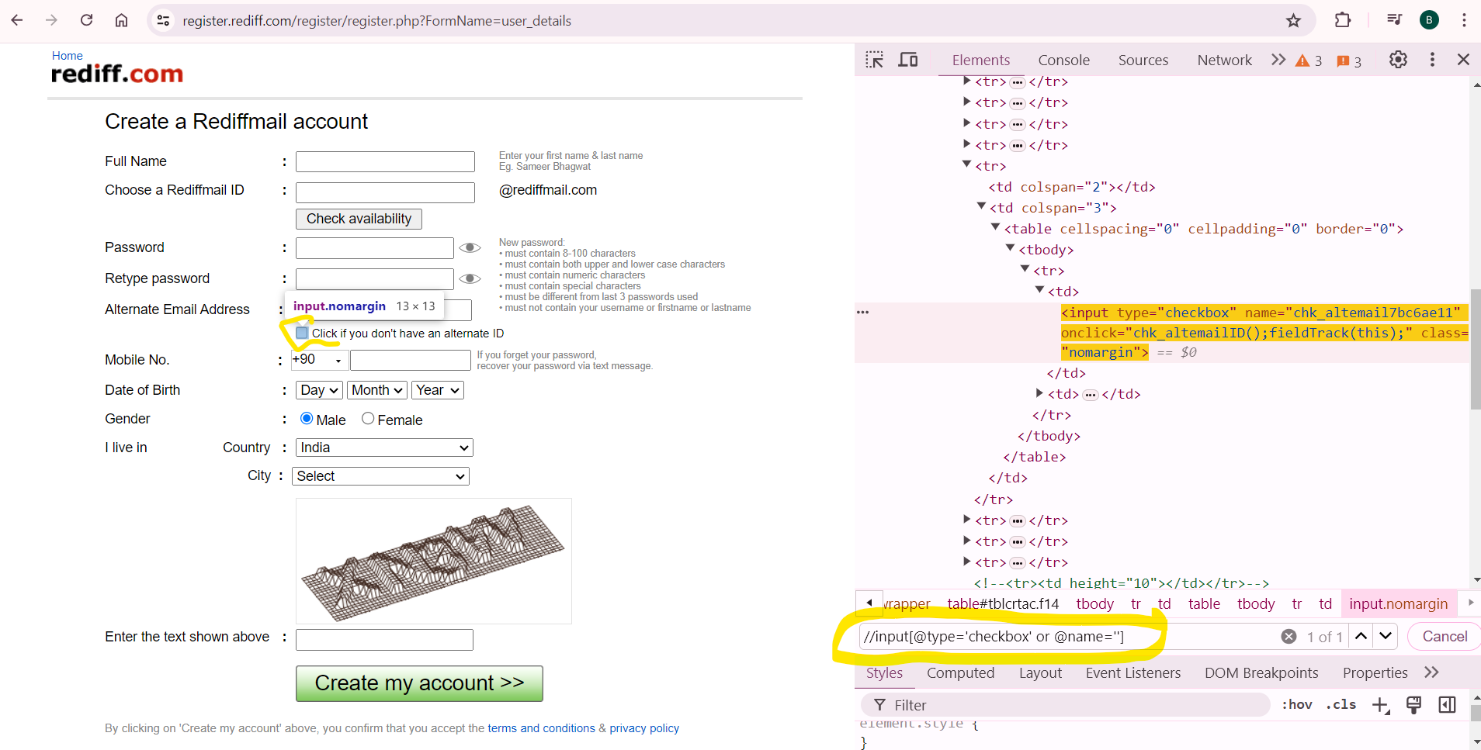
Using OR
//input[@type='checkbox' or @name='']
https://register.rediff.com/register/register.php?FormName=user_details

Slide 20
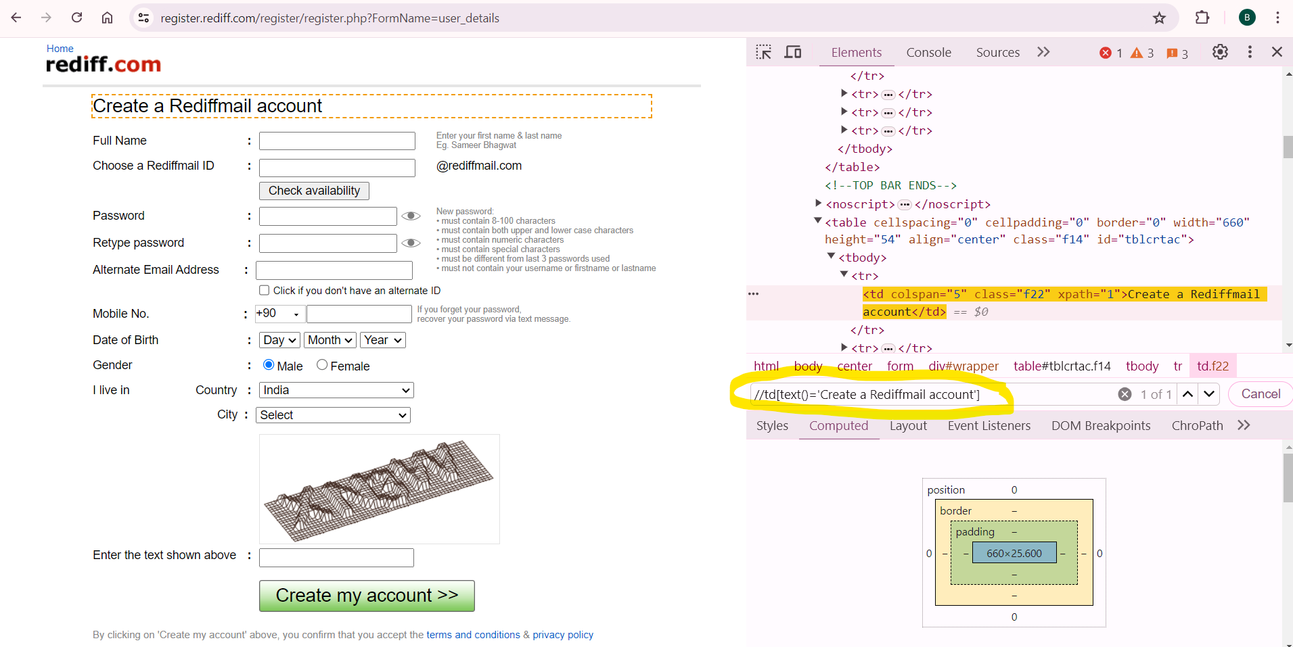
Use of text()
//td[text()='Create a Rediffmail account']
https://register.rediff.com/register/register.php?FormName=user_details

Slide 21
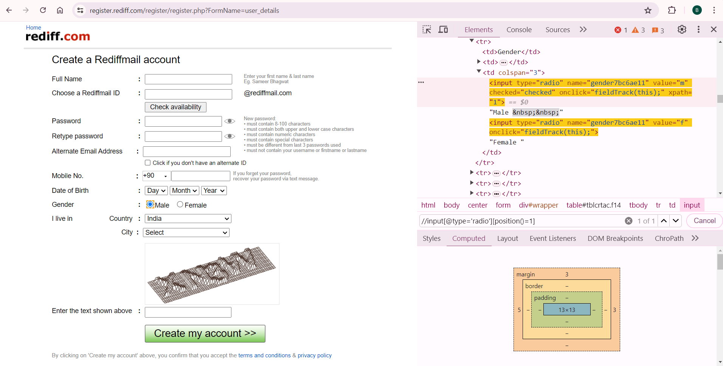
Using position()
//input[@type='radio'][position()=1]
https://register.rediff.com/register/register.php?FormName=user_details

Slide 22

Using position()
//input[@type='radio'][1]
https://register.rediff.com/register/register.php?FormName=user_details

Slide 23
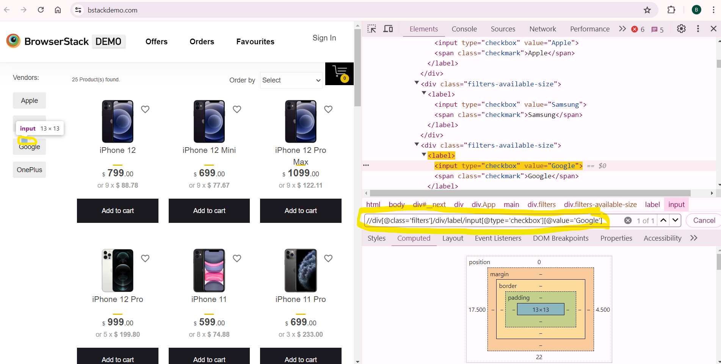
//div[@class='filters']/div/label/input[@type='checkbox'][@value='Google’]

Slide 24
CSS Selector EXAMPLES

Slide 25
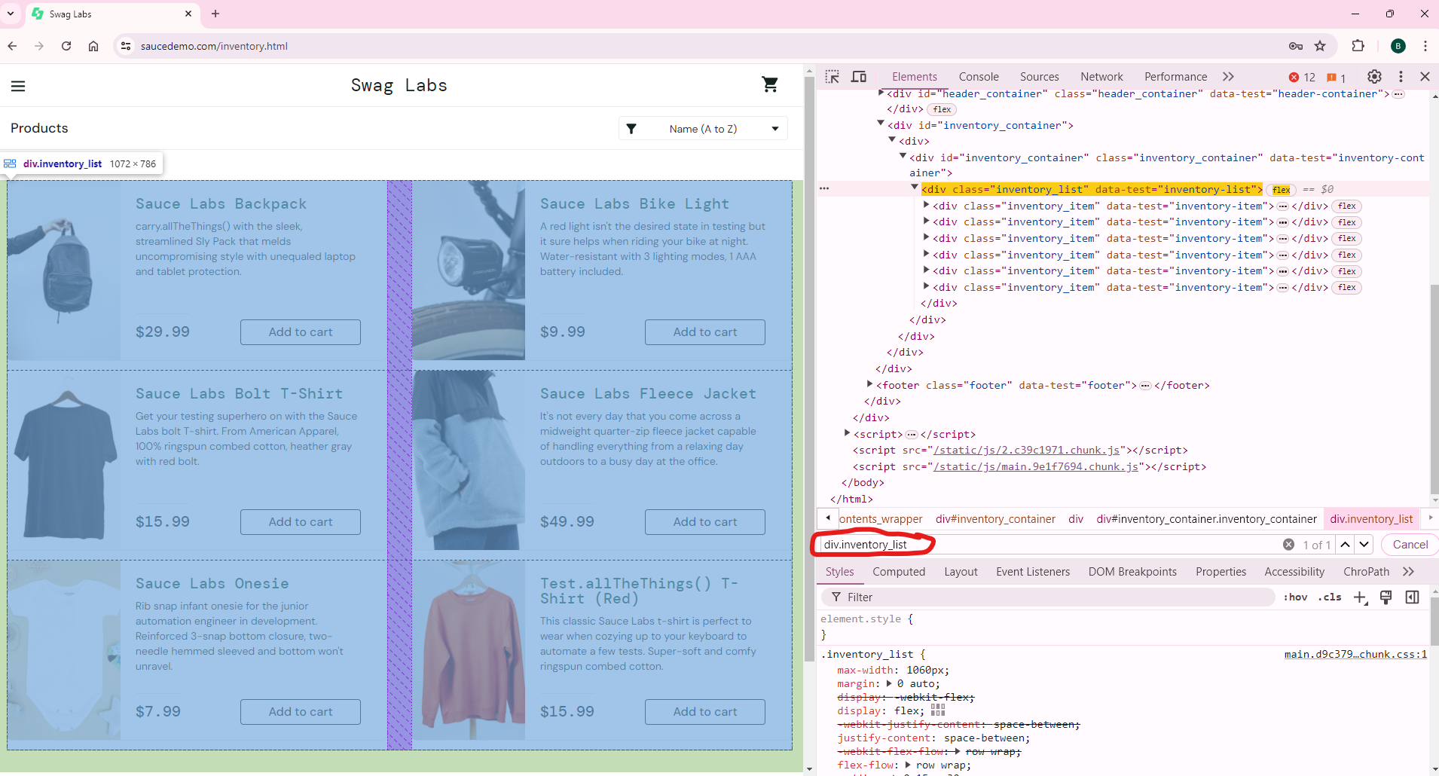
div.inventory_list
https://www.saucedemo.com/inventory.html

Slide 26
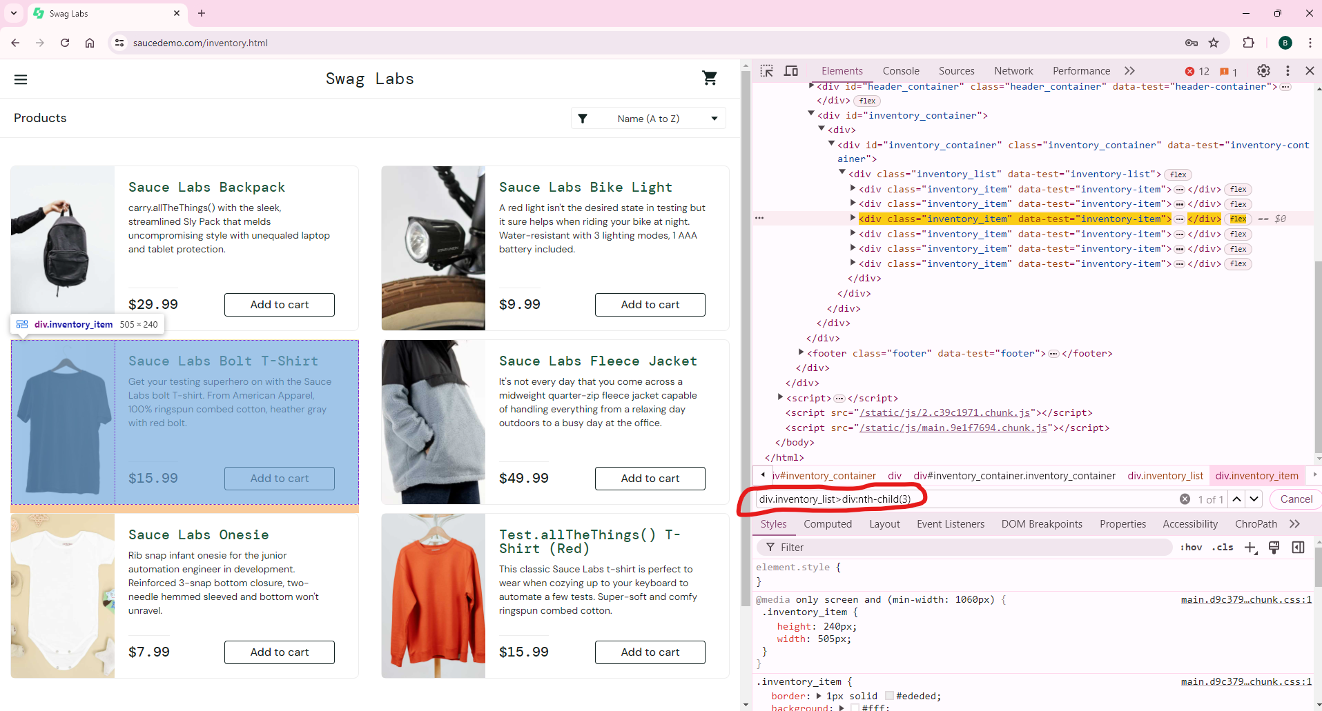
div.inventory_list>div:nth-child(3)
https://www.saucedemo.com/inventory.html

Slide 27
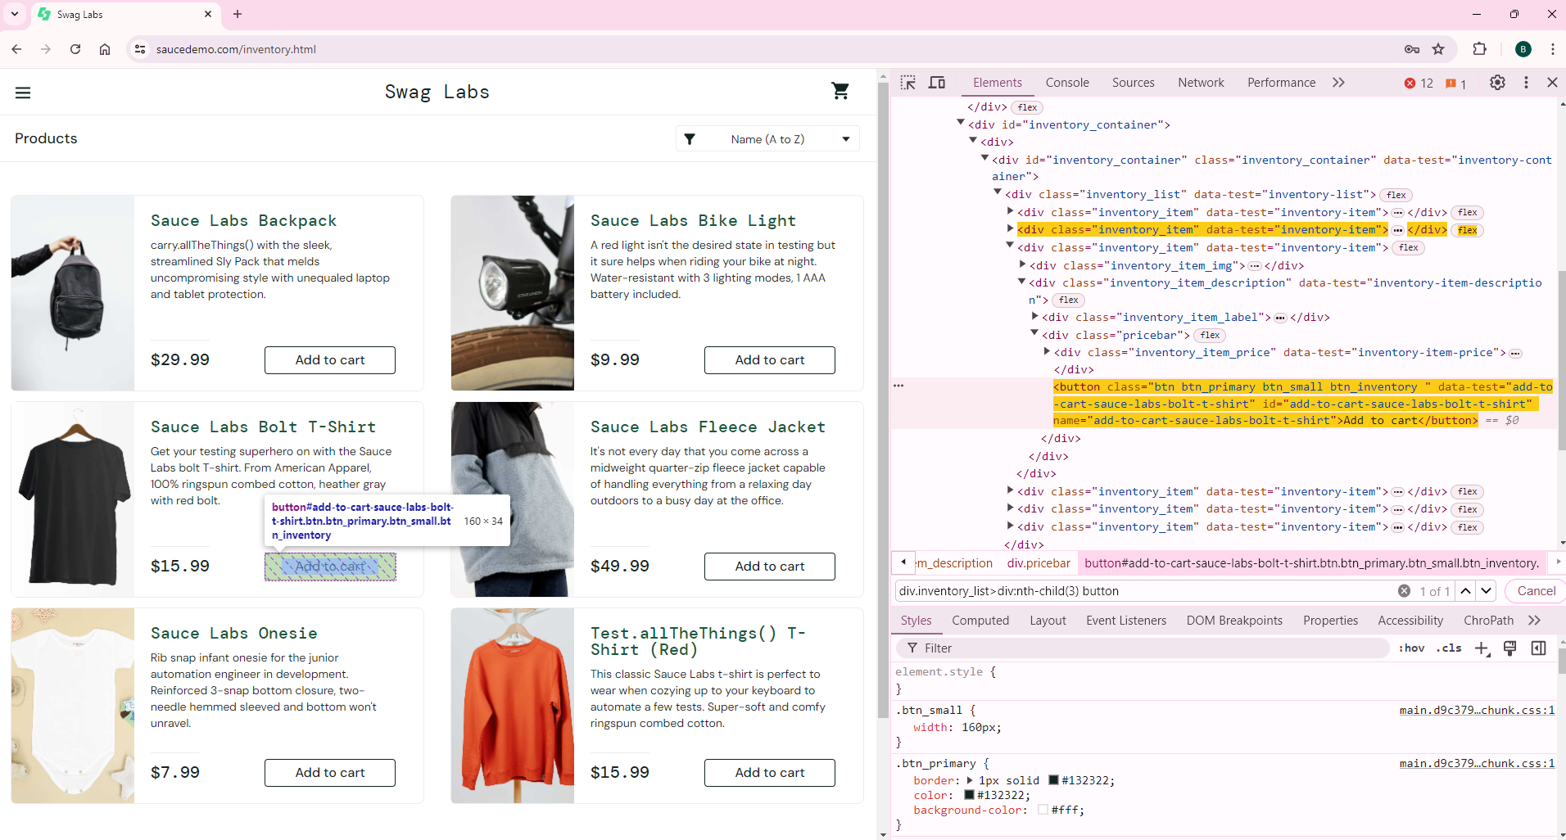
div.inventory_list>div:nth-child(3) button
https://www.saucedemo.com/inventory.html

Slide 28
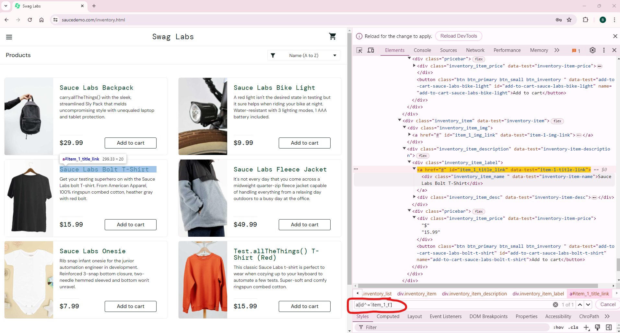
CSS SUB-STRING MATCHES
starts-with: ^
a[id^='item_1_t']
https://www.saucedemo.com/inventory.html

Slide 29
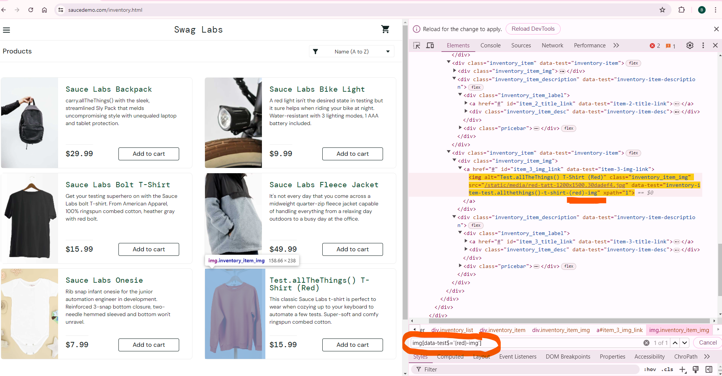
ends-with: $
img[data-test$='(red)-img']
https://www.saucedemo.com/inventory.html

Slide 30
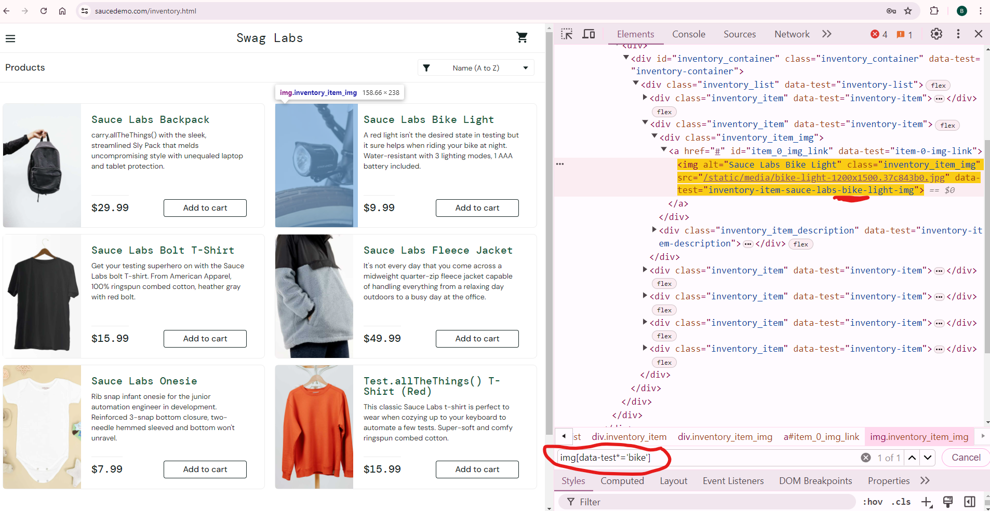
contains text : *
img[data-test*='bike']
https://www.saucedemo.com/inventory.html

Slide 31
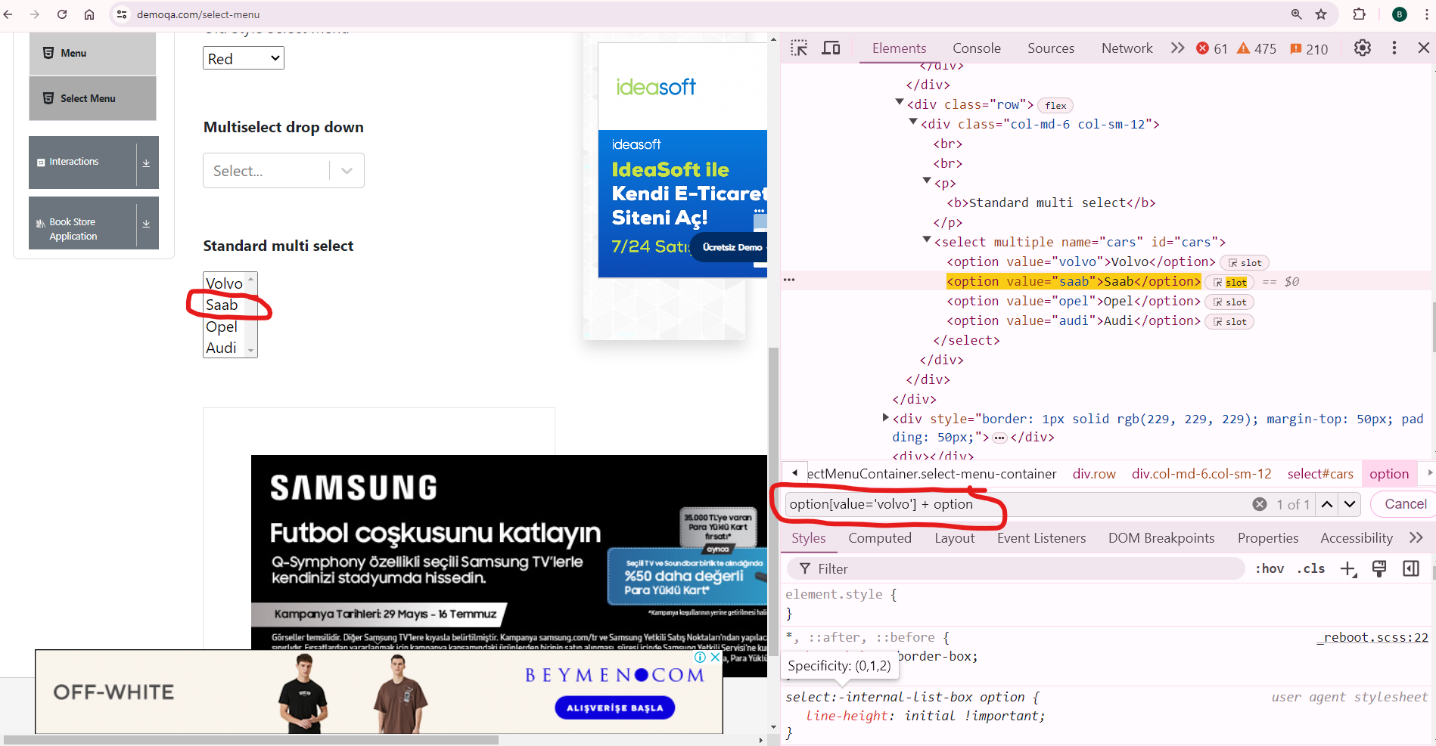
Locating Siblings
Adjacent Sibling
option[value='volvo'] + option
https://demoqa.com/select-menu

Slide 32
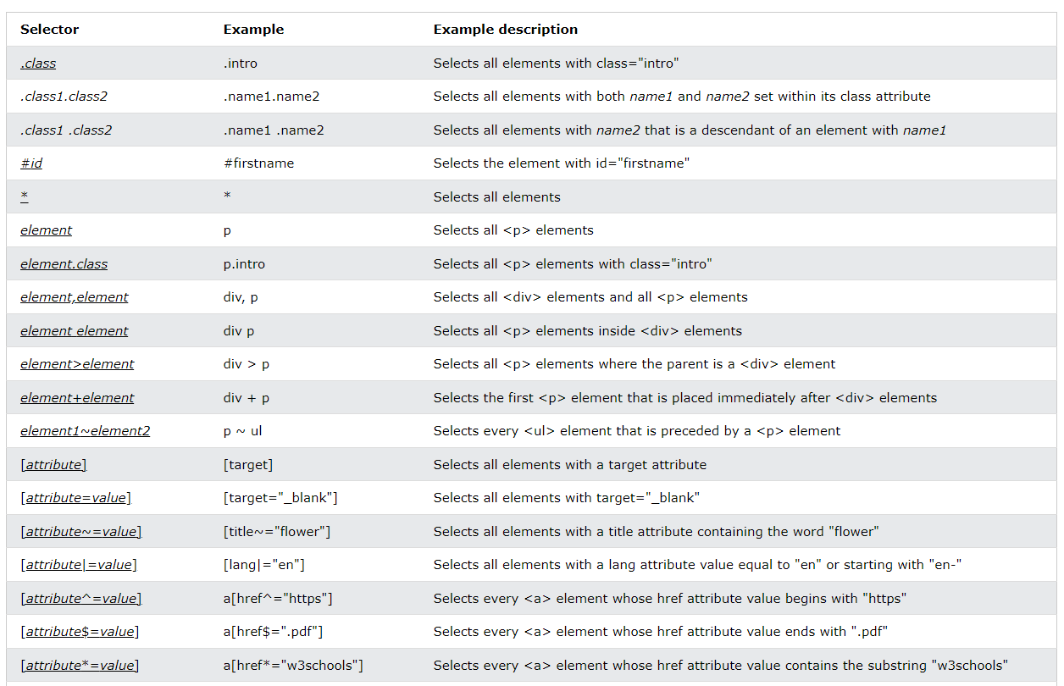
CSS Selector Cheat Sheet
Source: [4] Some of the CSS Selectors

Slide 33
References
[1] https://www.youtube.com/watch?v=H1_rmdsZ4gI
[2] https://www.softwaretestinghelp.com/xpath-axes-tutorial/
[3] https://www.w3schools.com/xml/xpath_axes.asp
[4] https://www.w3schools.com/cssref/css_selectors.php
https://testgrid.io/blog/dynamic-xpath-in-selenium/
https://www.browserstack.com/guide/xpath-locators-cheat-sheet

Slide 34
Thanks

